Slide 1
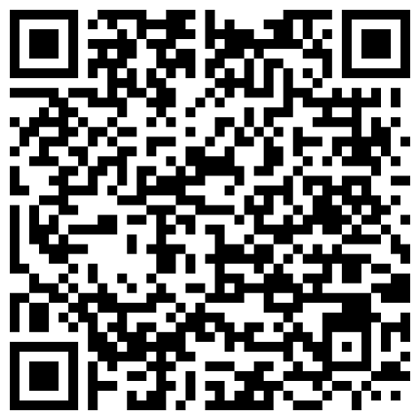
We are going to do a little experiment:
Stream of consciousness try to think of new, novel ideas
– what does "Idea" mean to you? –
My hypothesis is that, out of context or prompting, coming up with novel ideas will be hard. However, given the context of a this being the first real week in school, your mind is probably overloaded with new experiences, so it will be interesting to see.
The first part is simple: everyone open the following URL or scan the QR code ( https://otherrealm.org/unprompted )
And, on a blank page write down all the ideas that pop into your head!
Link to Google Doc
for ideas, no context

Slide 2



Assessing ideas: the forest, the trees, and the larger ecosystem of which both are a part
Aaron E-J

Slide 3
Engineering and Science are All About Thinking of New Ideas

Slide 4

But it is Important to First Identify the Problems
→💡
Which need new ideas

Slide 5
And then ask questions
?→💡
To validate their effectiveness

Slide 6
Don’t try and generate solutions and then go in search of a problem
?
?
→
?
?
→
?
?
?
?
💡___
→
?
?
→
?
?
→
→
→
→
→
→
→
→

Slide 7
But with the problem identified
!

Slide 8
What do you do if you are out of ideas?
?

Slide 9
Because inevitably in college, you will face situations where you_____________ run __________ out ______ of ____ Ideas

Slide 10
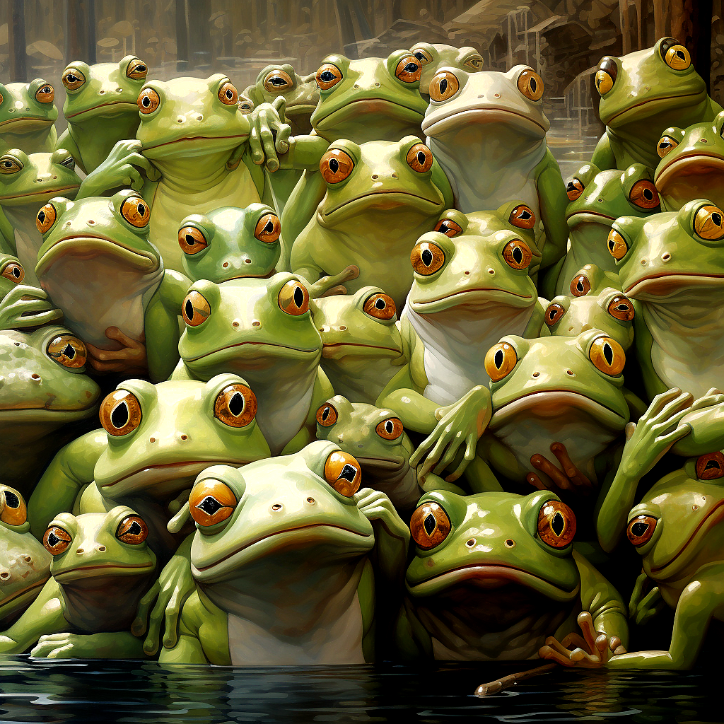
What do you do if you are out of ideas?

Slide 11

What do you do if you are out of ideas?

Slide 12

Try and think
outside the box

Slide 13
And then seek to ask more questions

Slide 14




Ways of thinking outside the box
Placing ourselves in novel situations
Roll playing (either about something related to the topic just in a different context, or something completely different)
Talking to people you don't normally talk to
Getting exercise
Meditating
Do you have other ways of thinking of new ideas that you have used when you were in a rut?

Slide 15
Problem/Solution vs. Idea/Ideation
Problem/Solution
You know there is a problem, so you know there is a need
If there are people who already have had this problem, likely there are already solutions for it
Idea/Ideation
You just had an awesome idea, but are there people who need it?
Has anyone else already had this idea?

Slide 16
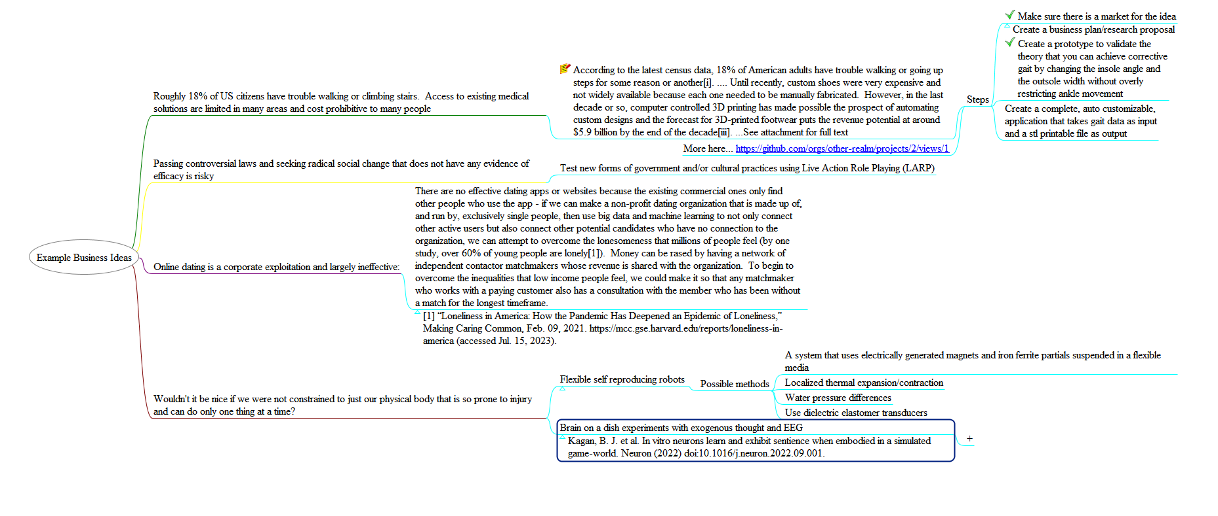
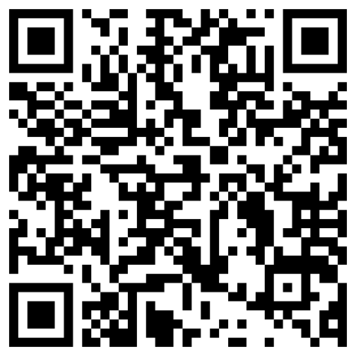
Some examples and ideas
Go to:
https://otherrealm.org/class2ideas
A QR code to the
Google doc

Slide 17
Analyze The Ideas
Efficacy? (how affective an idea is)
Usefulness in society? (how many people will benefit)
Are there already solutions that fulfill this challenge?
Will it be solving an unmet need, fulfilling an insatiable desire, or fulfilling an obligation?
Is there enough will and internal interest to sustain the amount of effort required for implementing the idea?
How can we work together to leverage our individual strengths and make each idea more achievable than if we were working alone?
How long and how difficult will it be to become a reality? Is it worth this effort?

Slide 18
Assignment
Continue brainstorming solutions on the shared Google doc and how they fit in with those we identified in class. Then, select the idea you want to research and develop further (it doesn’t need to be one you thought up, it can be anything on the list we created) and submit it on canvas along with a brief description of some of the reasons you decided go choose it based on the questions in the previous slide, before the next class. Make sure everyone submits their own idea in canvas, because everyone will be evaluating each other's selected ideas. Everyone will be working on each other's projects in a collaborative way in the future as well.

